Slide 1
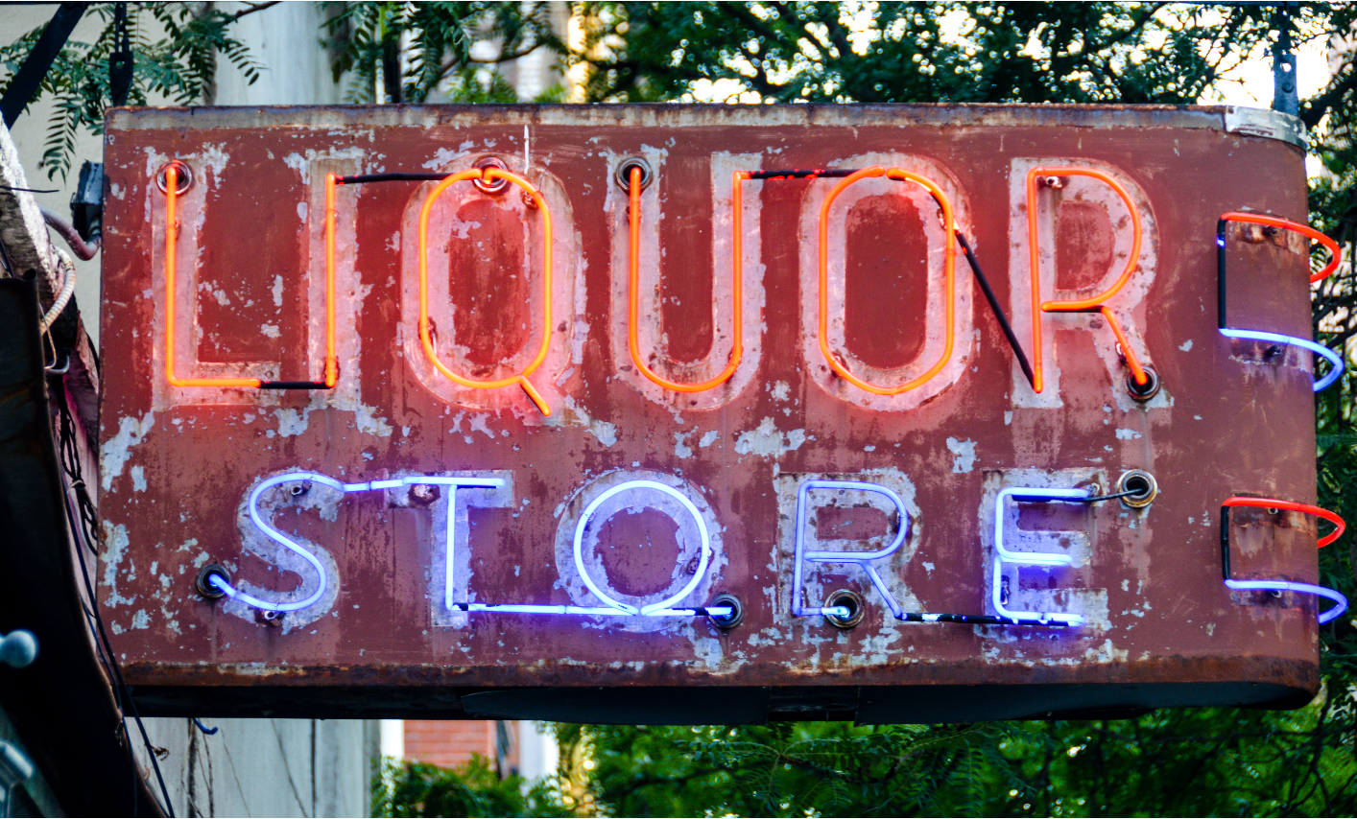
Iowa Liquor Sales
NYCDSA Cohort 023
Richa Vala
Jenny Yung

Slide 2
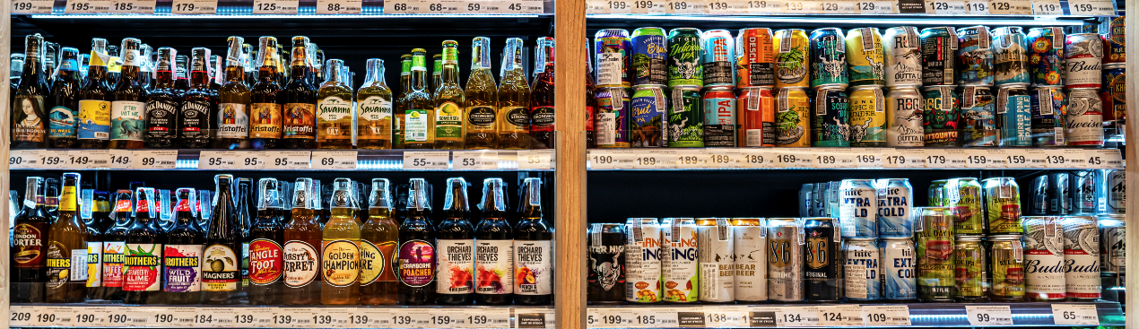
Proposal
Submitting a bid to win a contract to work for private investors
Investors want to open up liquor store(s) in Iowa but need guidance
Looking for a niche in the Iowa liquor market (lower competition)
Investors considering a handful of data scientist’s proposals, this is an initial view of the analysis & insights we can provide

Slide 3
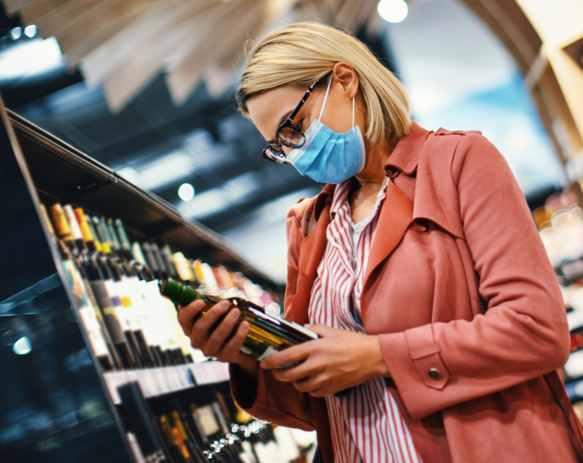
Understanding Iowa’s Liquor Market
Descriptive Analytics
Store Clustering
Market Basket Analysis

Slide 4
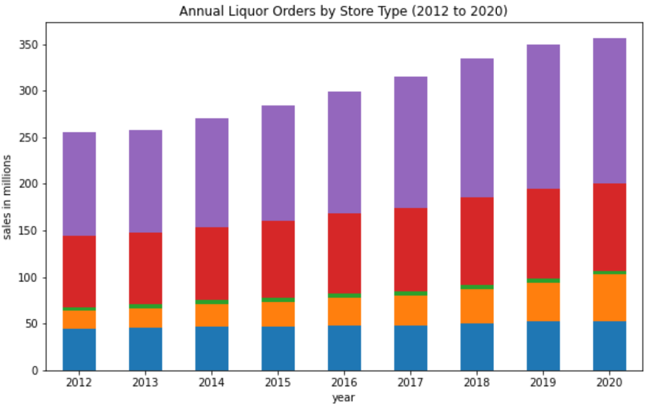
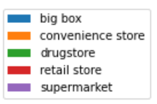
Size of Iowa Liquor Market in Orders ($)
70%
Supermarket & Retail store share
+4%
Increase in total orders to 2019

Slide 5
Average Annual Orders by Store Type
BIG BOX
SUPERMARKET
RETAIL STORE
$546K
$495K
$194K
97 stores
314 stores
485 stores
CONVENIENCE STORE
DRUGSTORE
$57K
$40K
872 stores
95 stores

Slide 6
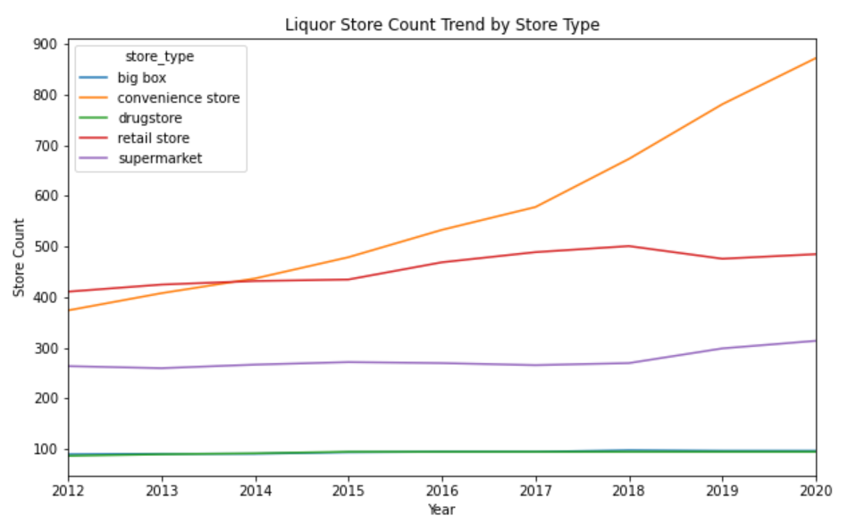
Growth of Iowa Liquor Market (Store Count)
374
Number of Convenience Stores in 2012
872
Number of Convenience Stores in 2020
+11%
Convenience Stores Avg Yearly Growth

Slide 7
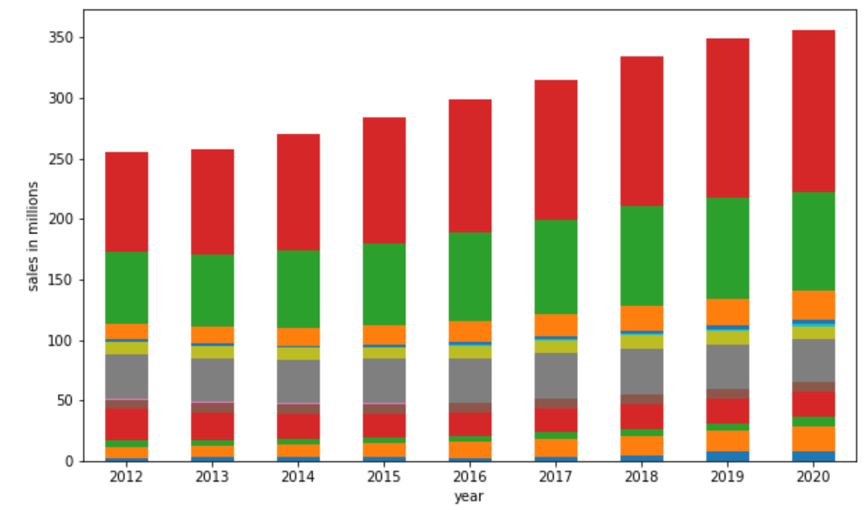
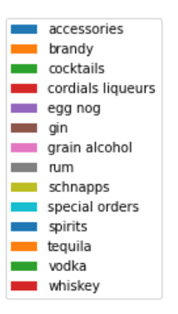
Annual Liquor Orders by Category

Slide 8
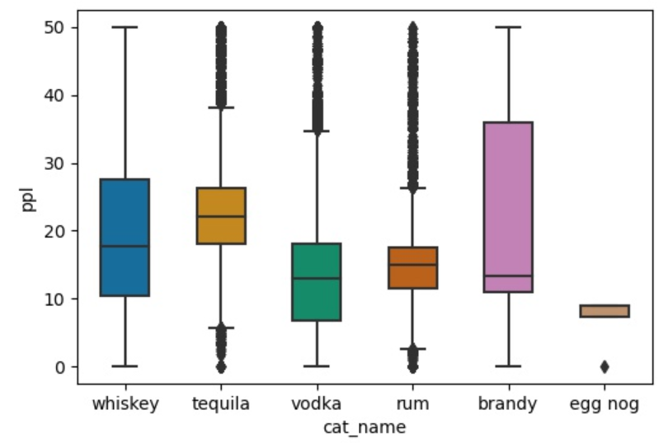
Price Per Liter by Liquor Type
Tequila $22.55
Whiskey $17.61
Rum $14.32
Brandy $12.04
Vodka $11.81
Eggnog $8.24

Slide 9
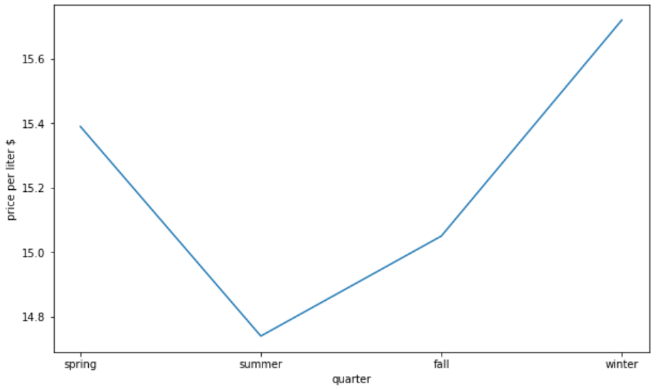
Seasonality - Avg Price Per Liter
Winter
$15.72
Winter
$15.72
Spring
$15.39
Spring
$15.39
Fall
$15.05
Fall
$15.05
Summer
$14.74
Summer
$14.74

Slide 10
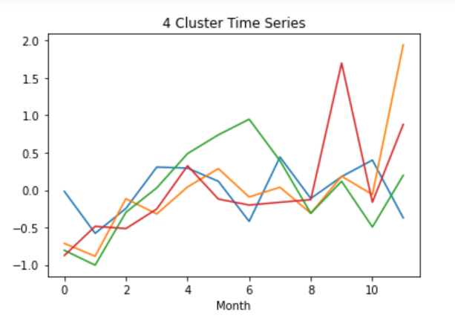
K-Means Clustering
Clusters = 4
Observations = 1,975 stores
Mean purchase orders by month

Slide 11
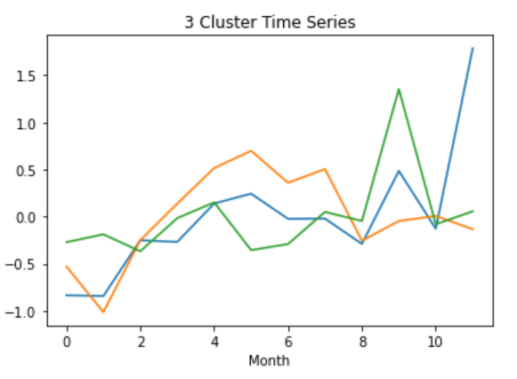
Clusters = 3
Observations = 1,975 stores
Mean purchase orders by month

Slide 12
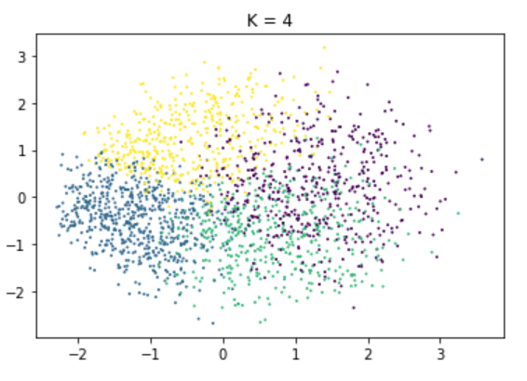
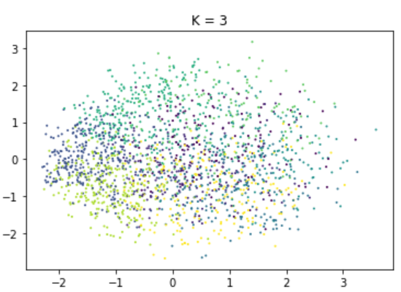

Slide 13
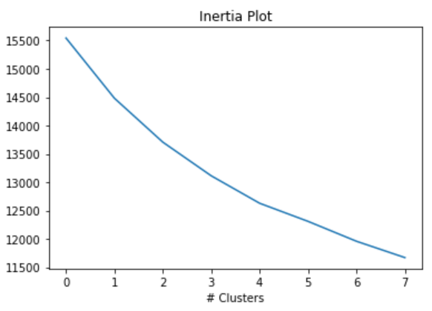
Elbow Plot

Slide 14
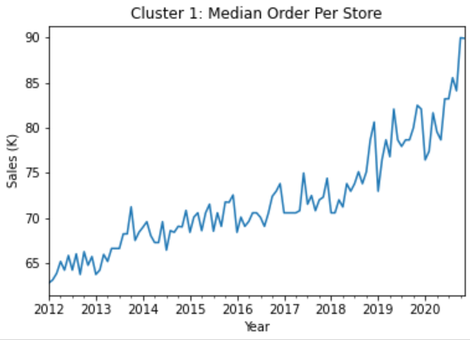
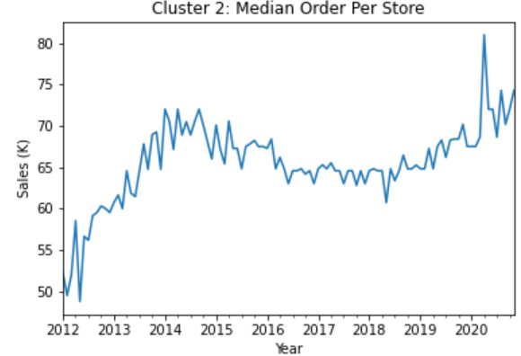
Cluster 1
Cluster 2

Slide 15
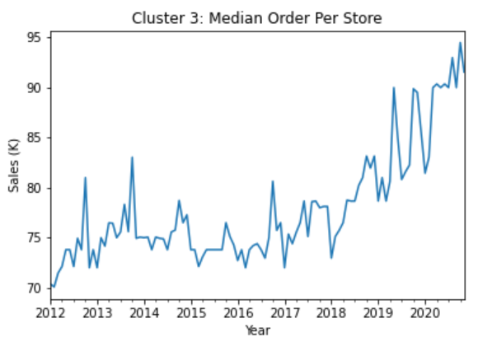
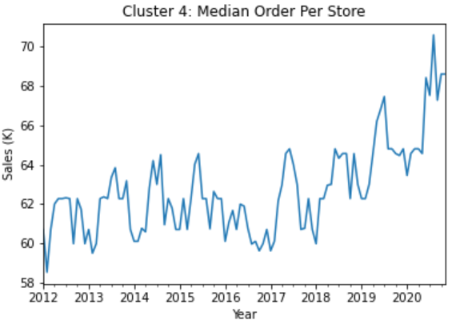
Cluster 3
Cluster 4

Slide 16
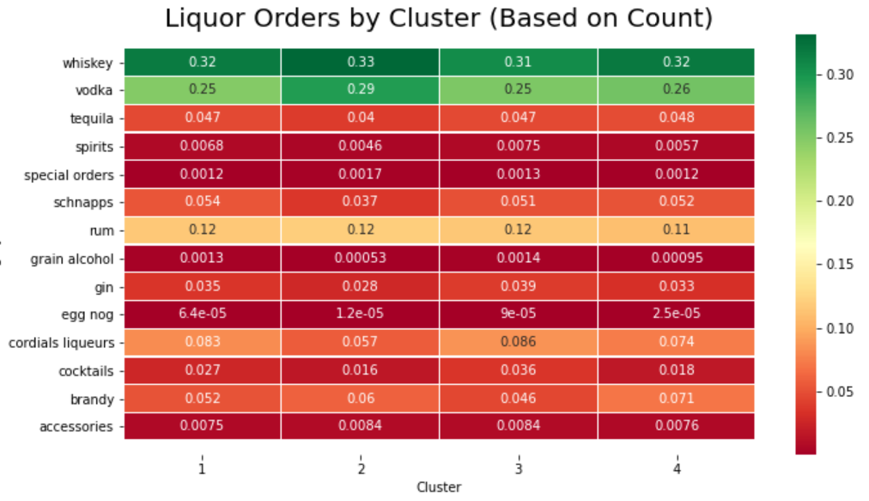

Slide 17
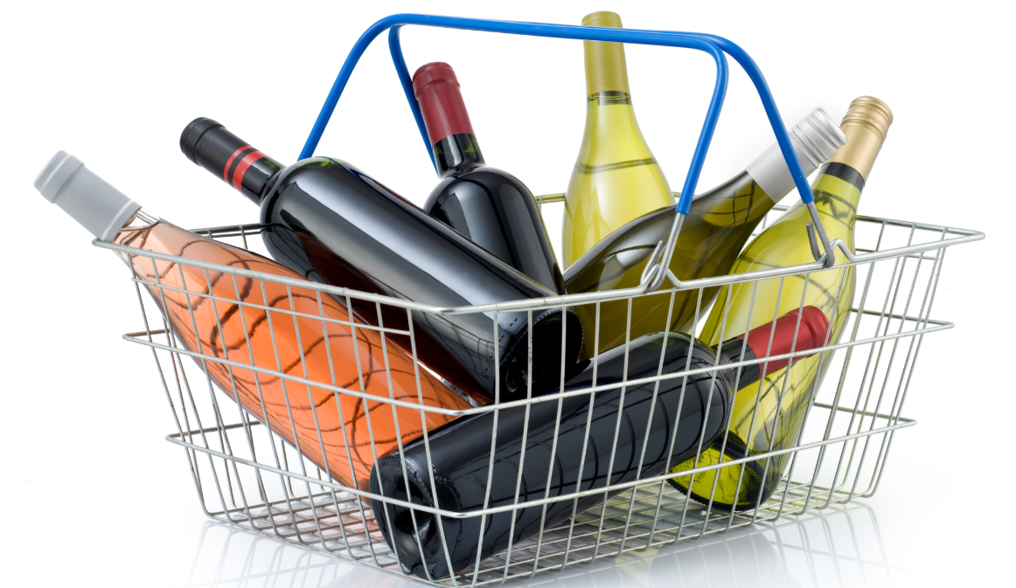
Market Basket Analysis
Apriori : Frequent Itemset Mining Algorithm

Slide 18
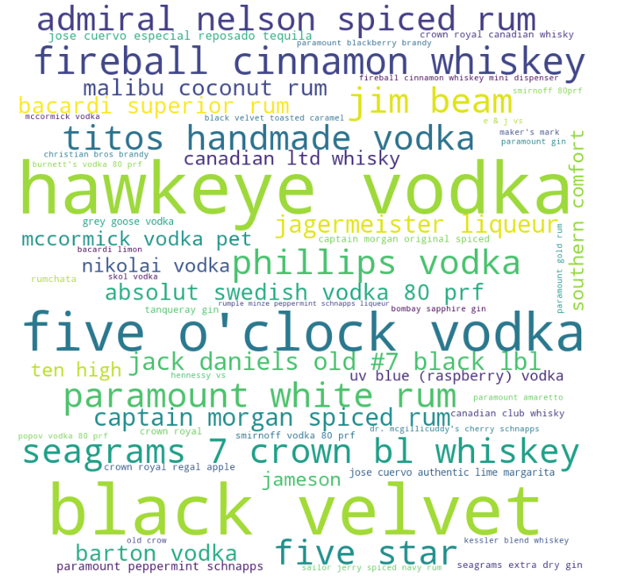
What’s Iowa’s Most Popular Liquor Brand?
Hawkeye Vodka
Black Velvet Whiskey

Slide 19
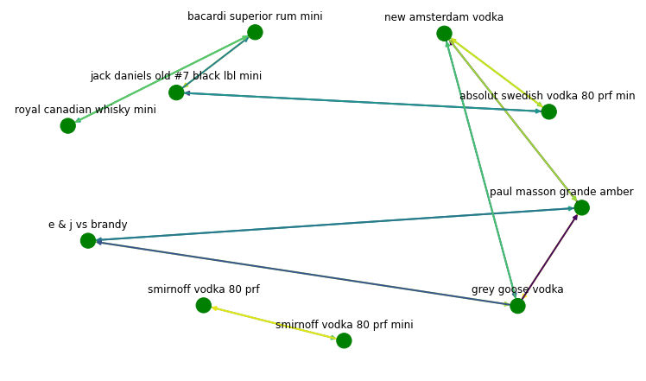
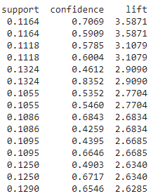
Association Rules For Convenience Stores

Slide 20
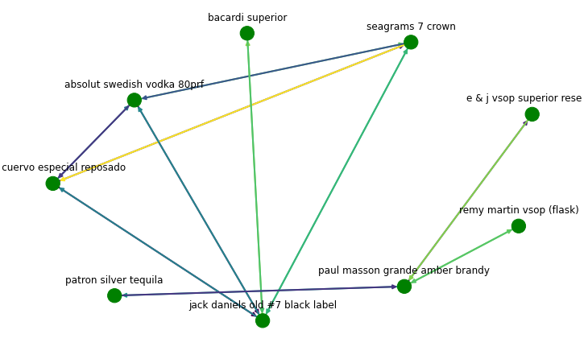
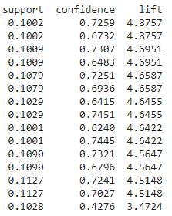
Association Rules For Retail Liquor Stores

Slide 21
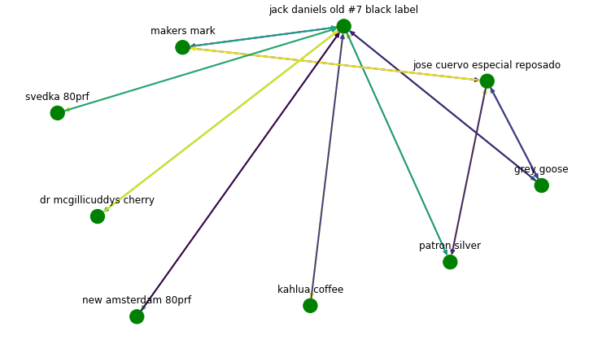
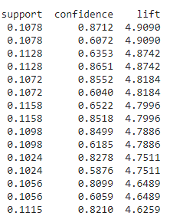
Association Rules For Supermarket

Slide 22
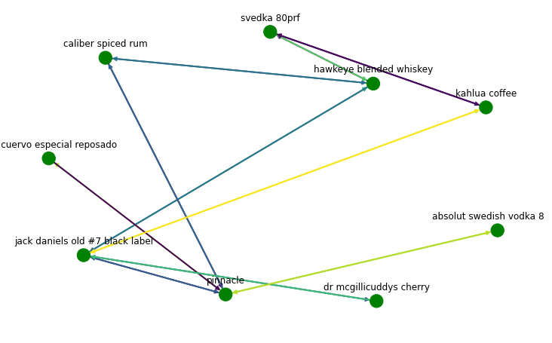
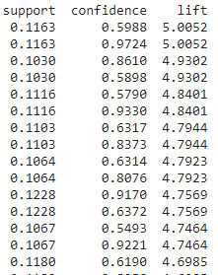
Association Rules For Big Box

Slide 23
Common Items Sold By Retail & Convenience Stores
Frequent Items
Hawkeye Vodka
Black Velvet
Captain Morgan Original Spiced Rum
Five O'clock Vodka
Fireball Cinnamon whiskey
Jack Daniels Old #7 Black Label
Jim Beam
Admiral Nelson Spiced Rum
Bacardi Supreme Rum
Crown Royal Canadian Whisky

Slide 24
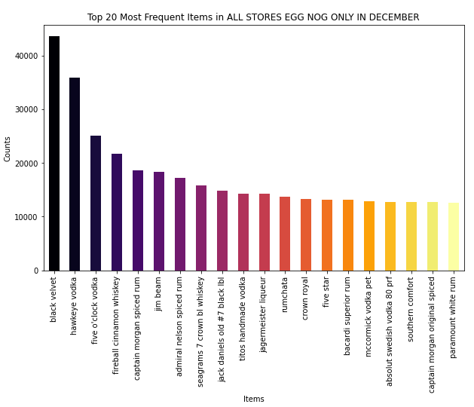
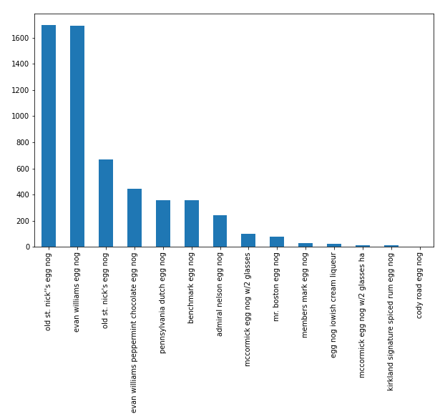
Seasonal Liquor : How Often Is Eggnog Sold?

Slide 25
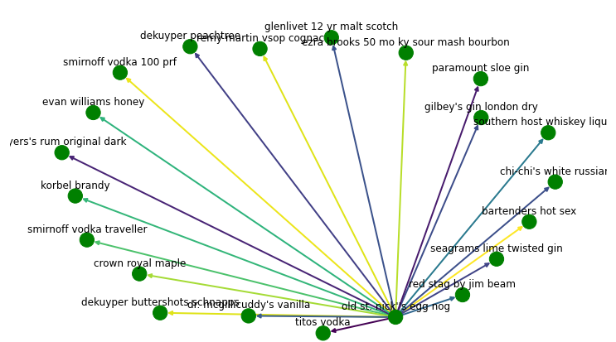
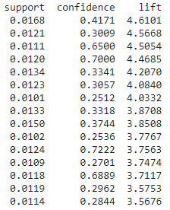
Association Rules For Eggnog

Slide 26
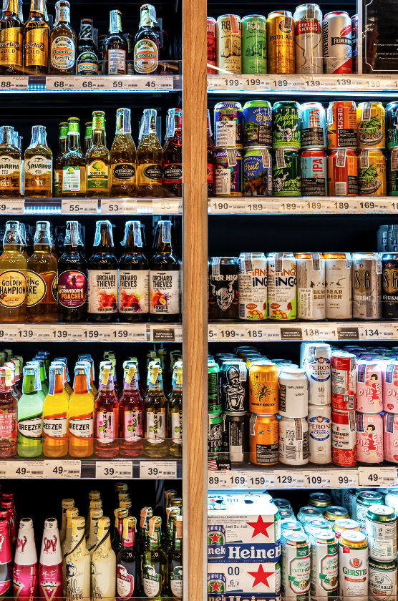
Initial Recommendations:
Growth in convenience stores is adding more competition to retail liquor stores
Iowans are loyal to their liquor and buy the tried & true - whiskey and vodka
Seasonality exists in products - especially in summer & winter
Basket associations between retail & convenience stores show similar products

Slide 27
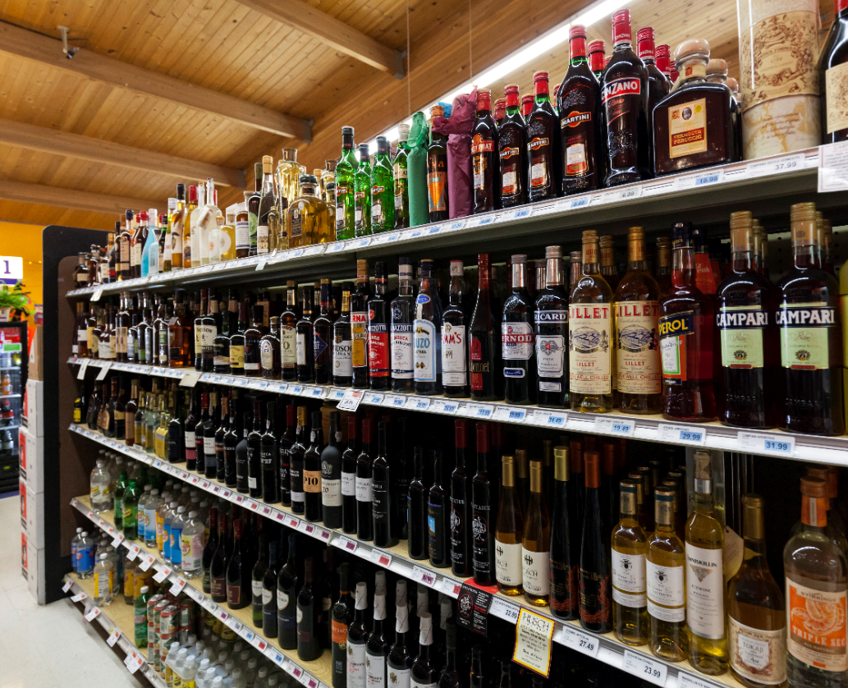
Thank you!

Slide 28
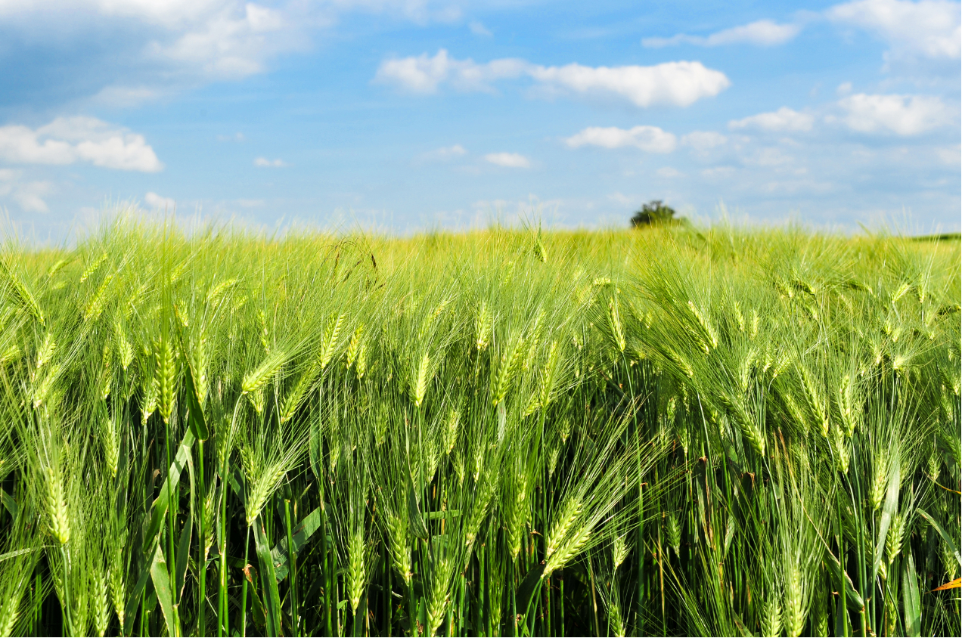
Appendix A
Iowa
Population: 31.5M
Population rank: 31st
Area rank: 26th
Density rank: 36th
Median Income: $60K
Income rank: 26th
Major cities:
Des Moines - 217K
Cedar Rapids - 133K
Economy:
Manufacturing
Agriculture

Slide 29
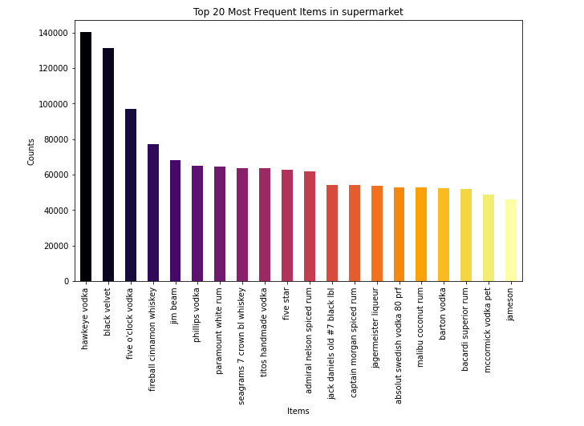
Appendix B
Frequent Items in Supermarket

